Slide 1
ONLINE MOBILE STORE
By
2021503058
2021503510
2021503536

Slide 2
CONTENTS
Introduction
Importance of the Website
System Information
Homepage
Login page
Mysql and php database

Slide 3
.
Screenshots
Conclusion
Thank You

Slide 4
Introduction
Provides a web interface to the user.
User can get details of mobiles like mobile model ,brand,price.
This website will help the user in selecting mobile phones and mobile accessories.
Any person can visit our website and can easily access the website.

Slide 5
IMPORTANCE OF THE WEBSITE
Mobile store is a website that has been designed to manage the mobile details.
The website has the following salient feautures :
1).It has modular in design.
2)It has database connectivity.
3)The system perform validation.

Slide 6
SYSTEM SPECIFICATION
Front-end tool : Html ,Css and Javascript
Editors : Note pad++,Xampp
Back-end tool :PHP , Mysql

Slide 7
Home Page
In the homepage, home, about, contact options are inserted. In this page you will see the login page and also you will see the slideshow.
In the homepage, home, about, contact options are inserted. In this page you will see the login page and also you will see the slideshow.
If you click the login button, it will navigate to the login page

Slide 8
Login Page
In the login page you will log into your account.
In this page, if you enter your account number and your password, it will go to the user details page and you will see your account details in that page.
Suppose you don’t have an account, click register, then it will go to the register page. In that page you will register your account. Then account number will be provided to you.

Slide 9
MY SQL DATABASE and PHP
IN our website ,we add database using php and sql software
A database is an organized collection of structured information, or data, typically stored electronically in a computer system. A database is usually controlled by a database management system (DBMS).

Slide 10
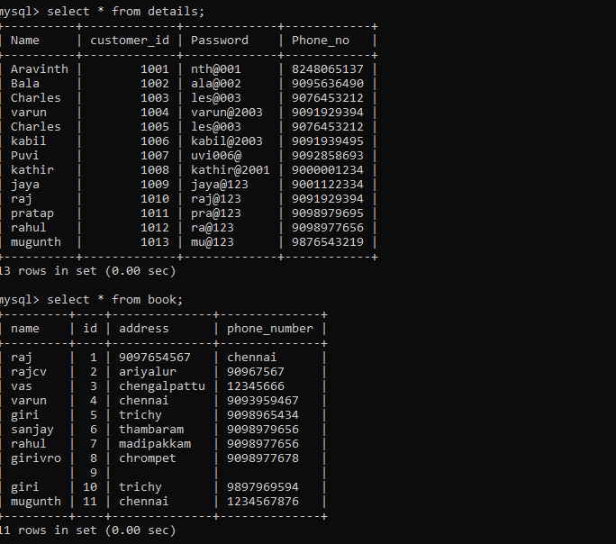
ScreenShots

Slide 11
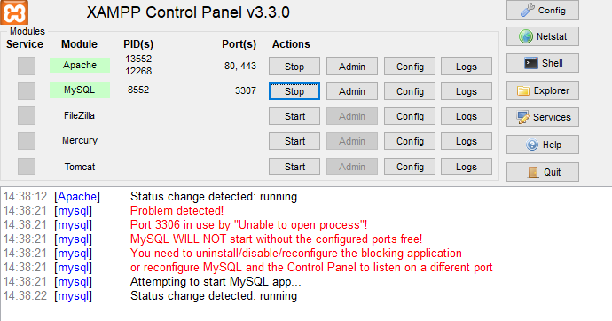
.

Slide 12
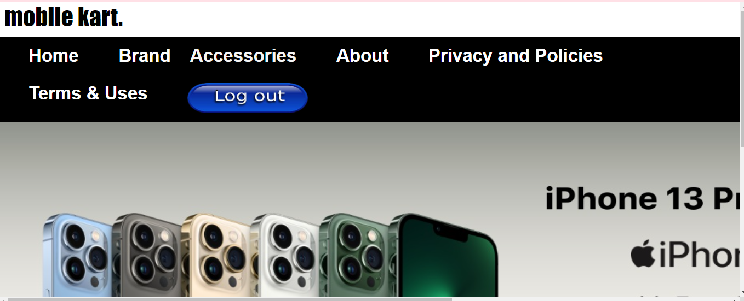
.

Slide 13
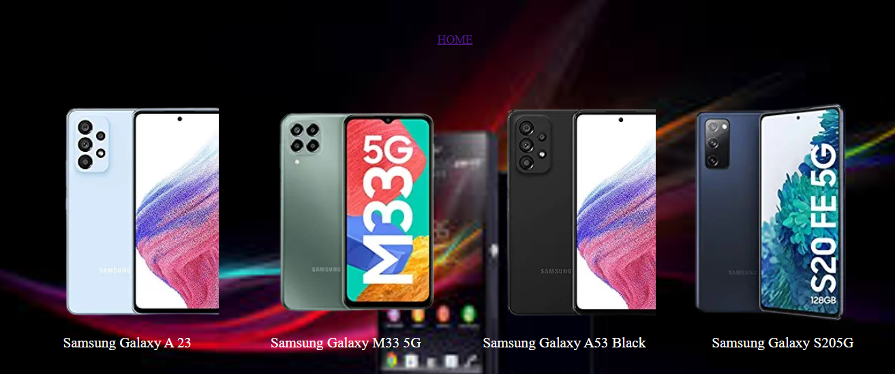
.

Slide 14
Conclusion
The main objective of the Online Shopping System is to manage the details of Shopping,Internet,Payment,Bills,Customer. It manages all the information about Shopping, Products, Customer, Shopping

Slide 15
.
THANK YOU

